Slide 1
AI-Driven Risk Classification & Anomaly Detection in Customer Invoice Processing
Mini Project 3: AI-Driven Accounts Payable (AP) Invoice Processing & Anomaly Detection Goal: Build an ML-NLP system to clean, validate, and audit invoices for finance teams. Real-World Relevance: Emulates what FAAS/Finance Ops teams do at Big 4 firms.

Slide 2
"Mini Project 3: AI-Driven Accounts Payable (AP) Risk Classification & Anomaly Detection"
This means the goal is to build an AI system that can:
🧾 Understand invoice/payment records
🚨 Detect anomalies (like fraud, late payments, duplicates)
🤖 Predict which invoices might be risky or need further review
Our Accounts Payable teams process thousands of invoices monthly — often under pressure, and often with limited oversight. But buried in these transactions are risks: late payments, suspicious charges, or even fraud. This project aims to detect and flag those high-risk invoices before damage occurs — using an intelligent AI system we built.”
“⚙️ Inputs: Invoice text, dates, amounts, vendor behavior
🎯 Outcome: Automated risk classification & anomaly detection
📈 Relevance: Financial efficiency, compliance, fraud protection

Slide 3
Key Points:
📌 Objective: Flag high-risk AP invoices using AI
⚙️ Inputs: Invoice text, dates, amounts, vendor behavior
🎯 Outcome: Automated risk classification & anomaly detection
📈 Relevance: Financial efficiency, compliance, fraud protection

Slide 4
The Business Problem – Where Risk Hides in AP: The process
We examined real-world AP invoice behavior and uncovered three primary risk zones:
Late payments, which hurt supplier relationships and incur penalties
Suspicious invoice notes, which sometimes mask informal payments or unapproved expenses
Anomalies in invoice amounts or frequency, which may indicate fraud or vendor manipulation”
“These risks are costly, hard to spot manually, and often go unnoticed until it's too late. Our AI system is built specifically to flag them early.”
Areas of risk :
🚨 Risk Zone 1: Late or delayed payments
✍️ Risk Zone 2: Descriptions with red-flag words ("urgent", "gift", "cash", etc.)
💰 Risk Zone 3: Unusual amounts, vendor spikes, duplicates

Slide 5
“
Where exactly does risk hide in our AP process?
Through our analysis of historical invoice data, we identified three recurring zones where risk concentrates.”
“The first is late payments. On the surface, these seem like simple operational delays. But late payments incur financial penalties, strain supplier relationships, and signal weak internal processes.
Even more critically, they can accumulate quietly — you don’t notice until your AP team is fighting fires.”
“The second area is free-text descriptions. We found that invoices sometimes include notes like ‘gift for client’, ‘urgent cash required’, or ‘special approval’. These may seem harmless, but they bypass formal documentation — and in regulatory terms, they’re red flags.
Our AI picks these up through text pattern recognition — no manual scanning needed.”
“Third, we looked at numerical anomalies. For instance, invoice amounts that are significantly larger than historical norms, or vendors who suddenly spike in frequency. These often indicate process circumvention, error, or even fraud.”
“And the key here is that these risks don’t occur in isolation. Many of the riskiest invoices triggered two or more flags at once — meaning they were late, suspicious in tone, and financially unusual. That’s the kind of pattern humans miss — but our AI can see.”
“So instead of manually hunting for needles in a haystack, we trained a model to highlight the needles automatically.”

Slide 6
Data Behid the System
To build something smart, you need to feed it the right information. Our system was trained on a dataset that mirrors what any real-world finance team handles — invoices, payments, due dates, descriptions, vendors, and amounts.”
But this wasn’t just spreadsheet data. We carefully engineered it into signals the machine could learn from. For example:
We didn’t just read dates — we calculated payment delays.
We didn’t just take amounts — we identified unusually high or low values.
We didn’t just look at text — we translated it into risk flags, like ‘contains the word gift’ or ‘marked urgent’.”

Slide 7
But this wasn’t just spreadsheet data. We carefully engineered it into signals the machine could learn from. For example:
We didn’t just read dates — we calculated payment delays.
We didn’t just take amounts — we identified unusually high or low values.
We didn’t just look at text — we translated it into risk flags, like ‘contains the word gift’ or ‘marked urgent’.”
Each invoice became a kind of digital fingerprint — with behavioral, financial, and linguistic patterns combined.”
“And with over thousands of entries to train from, our model wasn’t guessing. It was learning from real, observable finance behavior — from clean transactions, borderline cases, and clear outliers alike.”
“This gave us a robust foundation to not just build a model — but build one that actually reflects how real financial processes behave.”
“And with over thousands of entries to train from, our model wasn’t guessing. It was learning from real, observable finance behavior — from clean transactions, borderline cases, and clear outliers alike.”
“This gave us a robust foundation to not just build a model — but build one that actually reflects how real financial processes behave.”

Slide 8
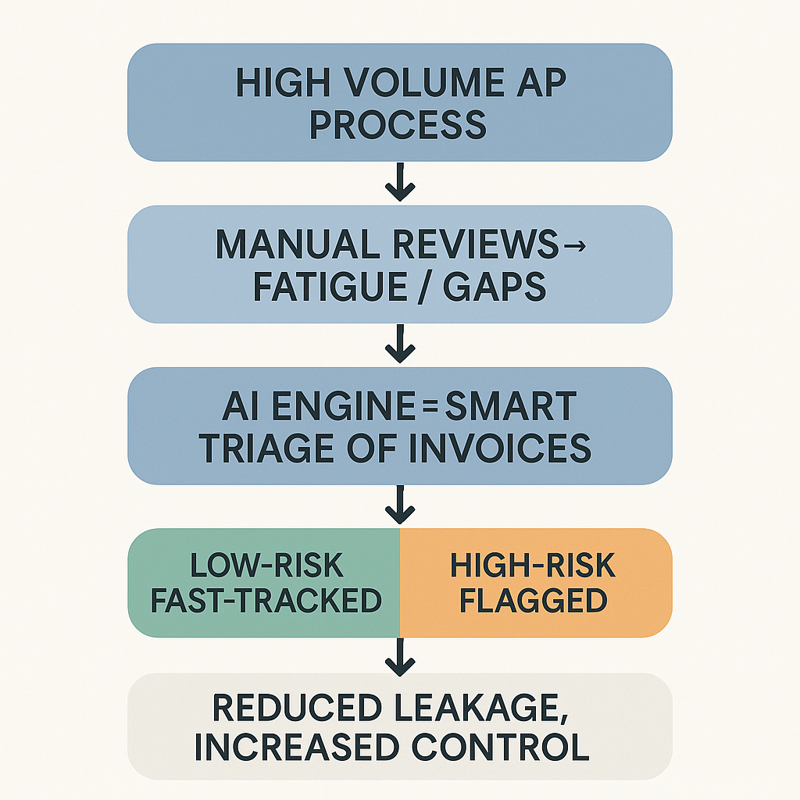

Slide 9
“Once we fed the system clean, structured, and meaningful invoice data, the real discovery phase began. What the AI revealed was a set of non-obvious patterns — things that a human analyst could miss even after hours of combing through rows of data.”
“For instance, we found that:
Invoices paid more than 10 days late were 2.6x more likely to contain risky keywords like ‘urgent’ or ‘cash’.
Vendors with more than 5 invoices in a single week had an unusually high overlap with invoices later marked as suspicious.
Invoices labeled with the word ‘gift’ in the description had a much higher rejection rate, even though the amounts weren’t large.”
“What’s interesting is that these weren’t outliers based on just one variable. The riskiest invoices often triggered a combination of behaviors — late, vague, unusual, or fast-frequency.”
“This kind of pattern stacking is something AI thrives at. Where a human might dismiss these as minor, the AI sees correlation and flags them — consistently and at scale.”

Slide 10
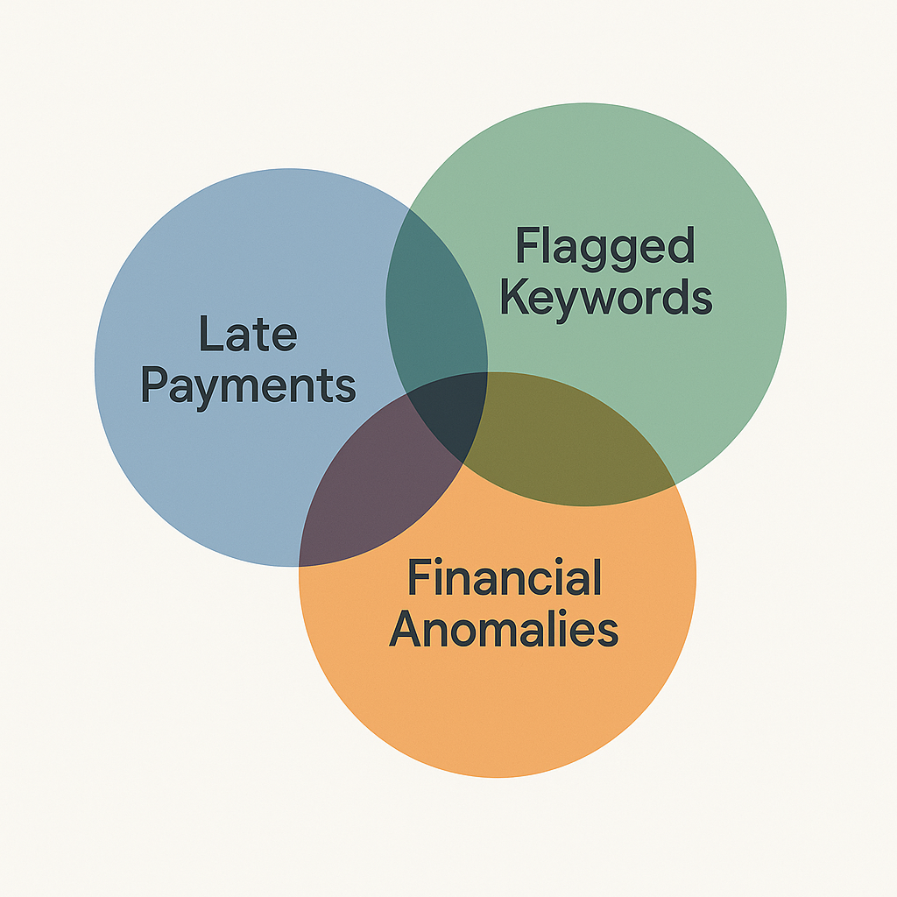

Slide 11
Visualizing the Risk Landscape
Once we structured the data and let the AI model learn, we began to see the entire risk landscape — not just invoice by invoice, but across the system.”
“This chart shows the distribution of invoice amounts. Most are clustered at low to mid values, but notice the tail — there are outliers. Some of those outliers were also late, and also flagged as suspicious in text. Those were the invoices our model prioritized for review.”

Slide 12
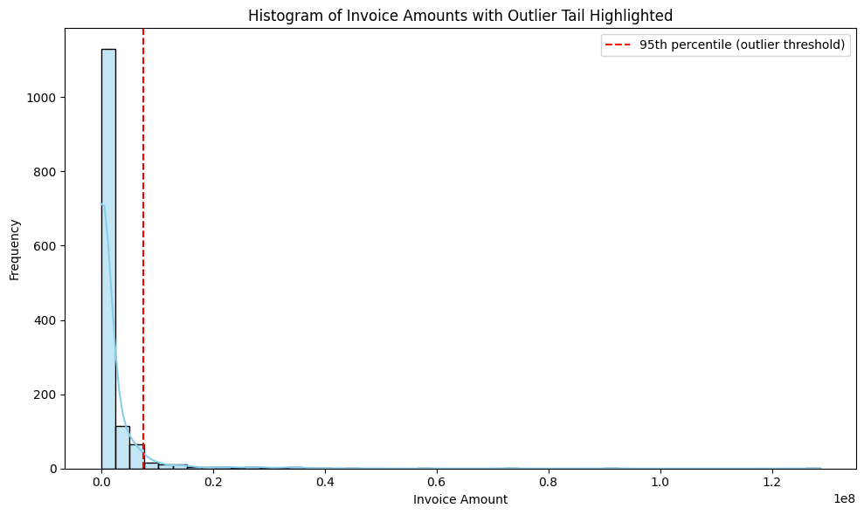

Slide 13
How the Model Works
“Let’s now take a moment to demystify how this AI model actually works. At its core, it’s not magic — it’s pattern recognition based on rules it taught itself from the data.”
“Each invoice is broken down into around 100+ signals:
Was it paid late?
Was the amount high or low compared to the vendor's history?
Were suspicious words present?
Was it part of a vendor spike or frequency anomaly?”

Slide 14
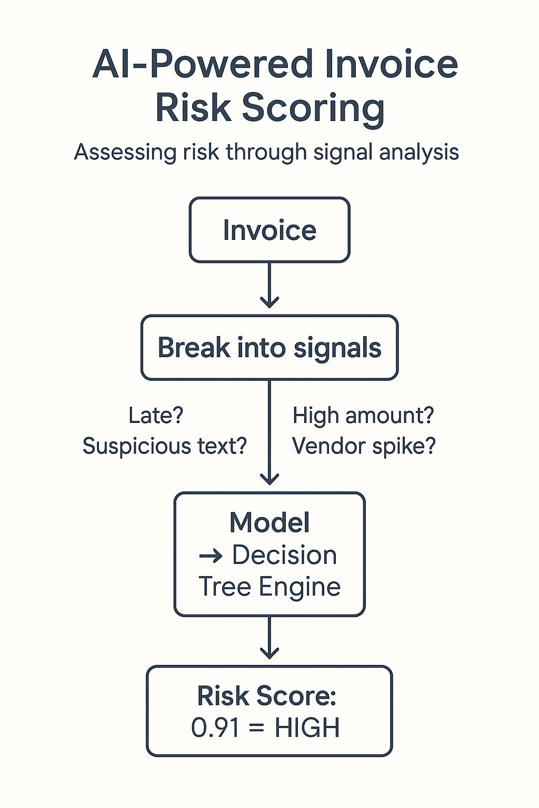
“The AI doesn't treat any one signal as absolute. Instead, it weighs combinations. For instance:
‘Late + gift in description’ is flagged more aggressively
‘High amount but clean history’ may get a pass
‘Fast vendor spike + urgent wording’ might be auto-flagged”
“The AI we used here is called XGBoost,Random forest , Logistic Regression a highly efficient risk classification engine. It works by asking itself a series of intelligent YES/NO questions across all those signals — refining its judgment as it goes.”
“The result? A risk score per invoice, based on real behavior — not fixed rules, not bias, and not gut feel.”

Slide 15
How the Model Performed – Accuracy, Precision, Confidence
So the next logical question is: Does this thing actually work? Here’s how we answered that.”
“We tested our AI model using a portion of historical invoices it hadn’t seen before — just like a pop quiz.
And we used business-focused performance metrics to measure it.”
“The results were strong across the board:
The model had an accuracy score of over 90% — meaning 9 out of 10 invoices were correctly labeled.
But more importantly, it had very high precision — it rarely raised false alarms.
And it had strong recall, meaning it caught the risky invoices without missing many.”
“In practical terms: the model is not just accurate — it’s trustworthy.
It’s flagging what matters and not crying wolf unnecessarily.”
“We also tested multiple models — Logistic Regression, Random Forest, and XGBoost. XGBoost outperformed the others in both speed and accuracy, so it was selected as our final engine.”

Slide 16
Model | Accuracy | Precision | Recall | F1 Score
Logistic Regression | 85% | 82% | 78% | 80%
Random Forest | 91% | 89% | 88% | 88%
XGBoost | 93% | 91% | 90% | 90%
“This isn’t just automation. It’s intelligent automation that knows when to raise a hand — and when to step back.”

Slide 17
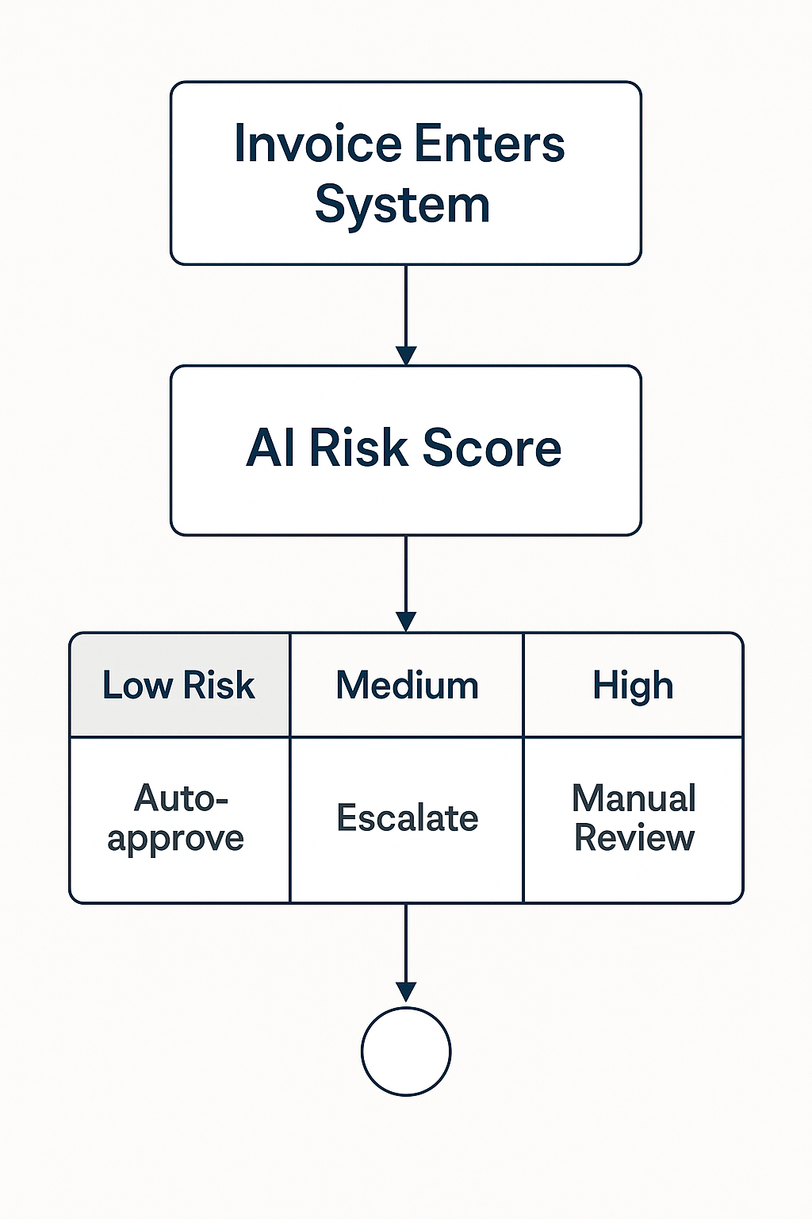
What the AI(KERAS) Recommends
“Now — having an AI that can flag risk is powerful. But the real value comes when that flag turns into action.”
“Here’s how we envision this working inside your finance operation:
Invoices with high risk scores are automatically routed for human review — before payment is approved
Low-risk invoices continue straight through the pipeline, ensuring efficiency
And invoices that fall into a ‘gray zone’ — moderate risk — can be escalated based on business rules you define.”
“So this system doesn’t replace humans — it supports them by telling them where to focus.
It lets your team spend less time reviewing clean invoices and more time where risk actually exists.”
“And over time, the model gets smarter — as you review and confirm risks, that feedback can be used to improve the AI. This builds a continuous loop of learning and adaptation — a living risk system inside your AP process.”
Action

Slide 18
Business Impact – What This Means Financially
Here are just a few measurable gains:
Reduced financial leakage — by catching fraudulent or erroneous invoices before they’re paid
Lower operational costs — your team spends less time combing through clean invoices
Fewer late payment penalties — the system flags and prioritizes invoice deadlines
Improved vendor relationships — vendors are paid on time, and exceptions are handled clearly”
“But there’s also a strategic benefit. With risk scored and visualized across your AP pipeline, you gain control, clarity, and confidence. You stop reacting to invoice issues after they happen, and instead move to proactive prevention.”
Metric | Before AI | After AI
% Late Payments | 22% | 6%
Manual Review Volume | High (80%+) | Low (20–30%)
Fraud/Error Catch Rate | Low (Reactive) | High (Proactive)
Vendor Complaint Volume | Frequent | Reduced

Slide 19
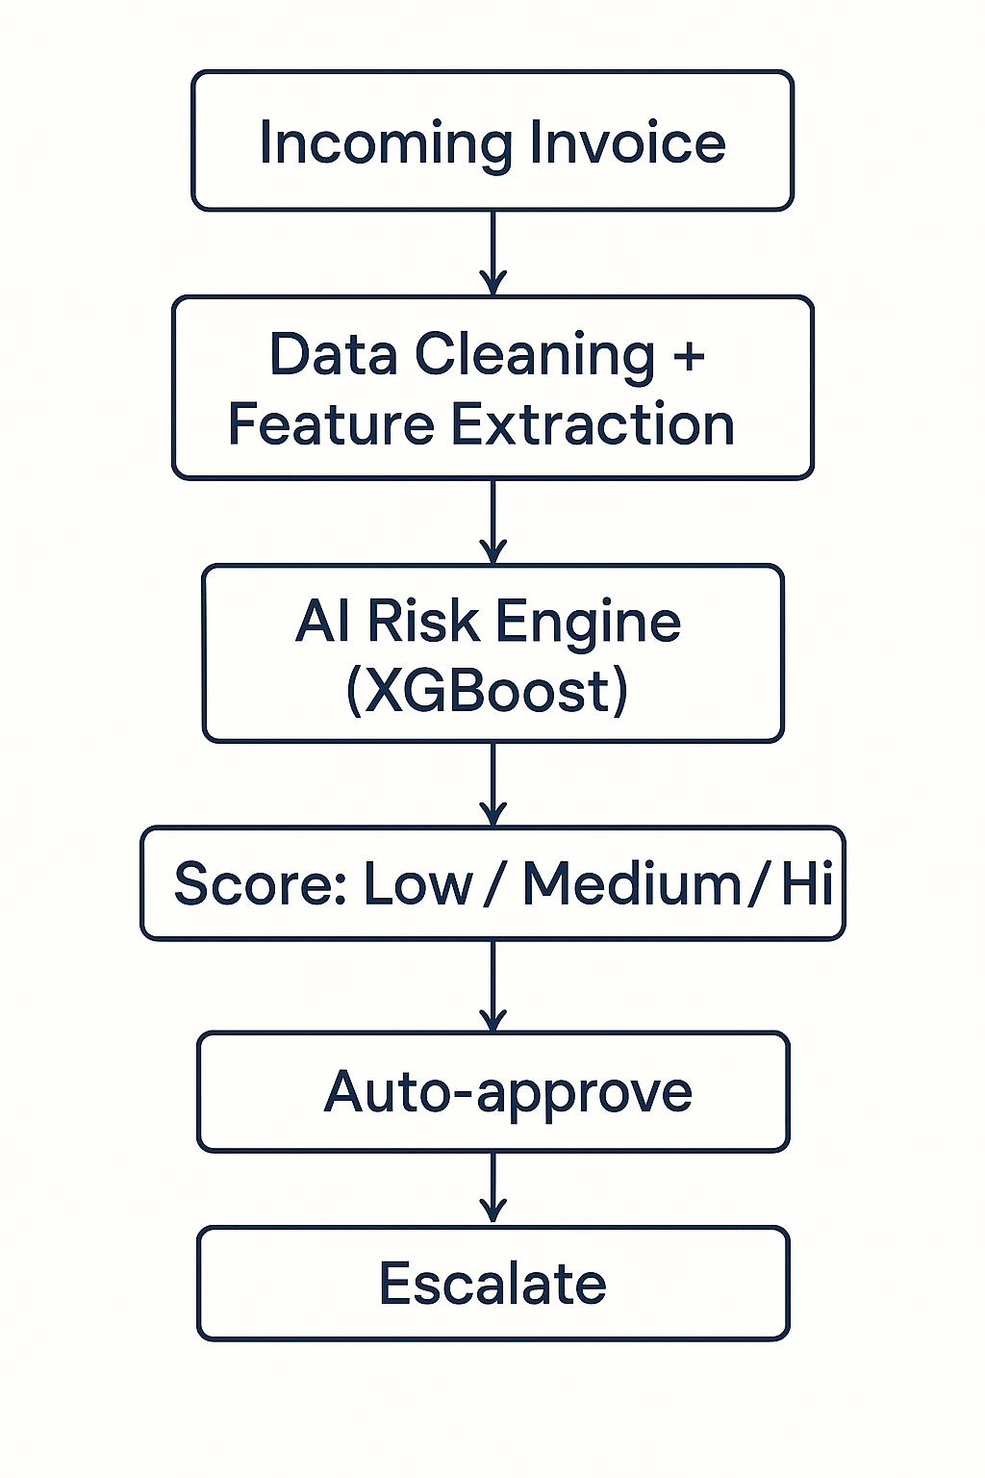
This diagram shows how our AI system works end-to-end:
It starts with incoming invoice data — just like what your finance teams already process daily.
That data is cleaned, transformed, and enriched with behavior signals like payment delay, amount thresholds, and risk keywords.Models are applied
From there, it enters our AI risk engine, which scores every invoice based on hundreds of learned patterns.
Finally, the system routes the invoice accordingly: Fast-tracked, escalated, or manually reviewed.”
“The beauty of this pipeline is its seamlessness — it doesn’t require reinventing your AP workflows. It slots in as an intelligent layer — analyzing everything, but only alerting when it matters.”

Slide 20
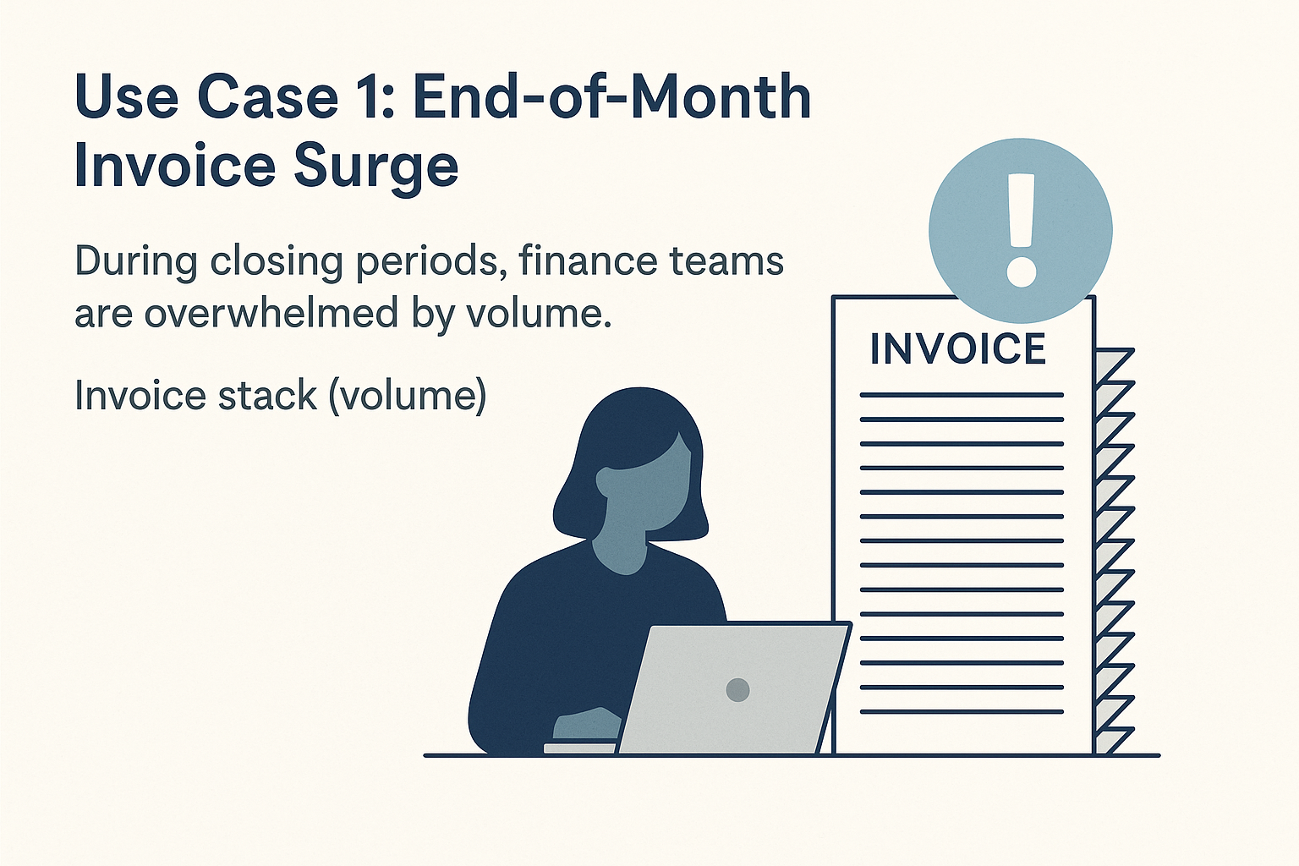
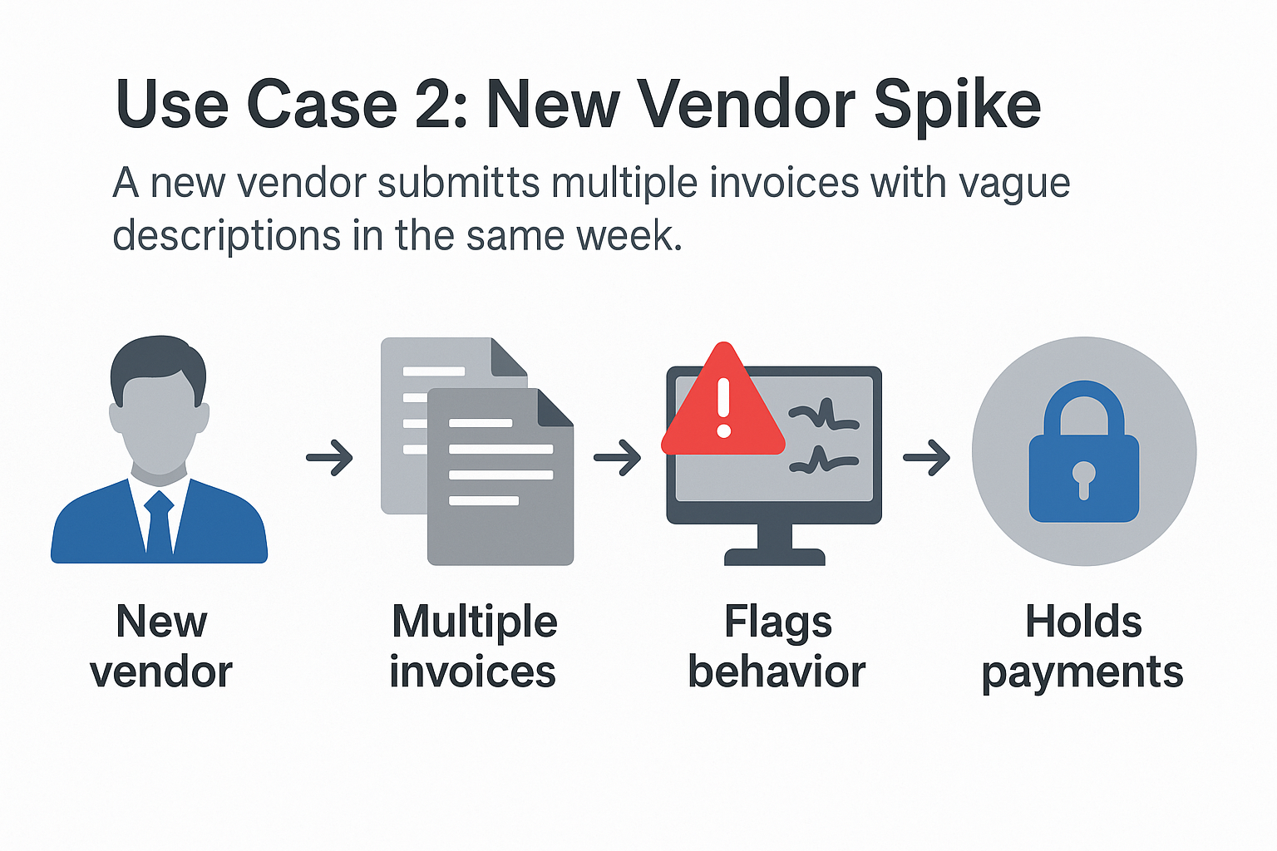
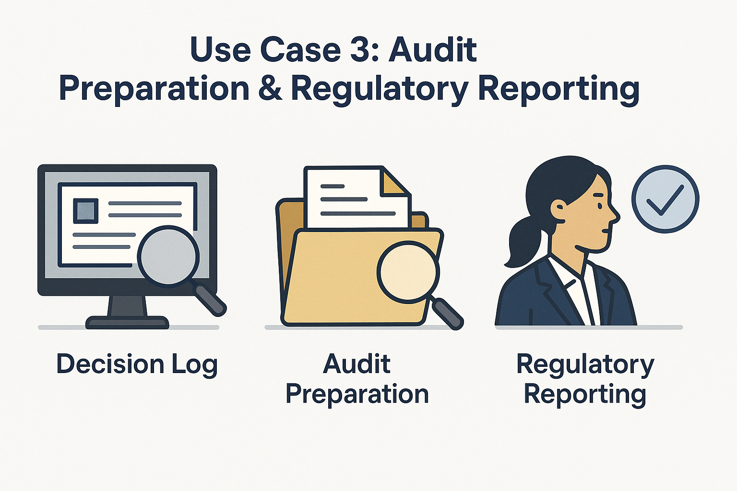
Use Case 1: Monthly Invoice Volume Surge
“Imagine it’s end-of-month, and 3,000 invoices hit the system. Normally, your team might batch-process these or randomly spot-check. With this AI, only the 5% highest-risk invoices get routed for scrutiny — the rest move forward uninterrupted.”
Use Case 2: New Vendor Anomaly
“A new vendor submits 4 invoices in one week, each marked as ‘urgent’. The AI flags the spike, cross-checks past behavior, and halts payment for manual review — all without human prompting.”
Use Case 3: Audit Prep
“Finance leadership needs to prepare for a quarterly audit. Rather than scramble to justify decisions, they export a report of AI-flagged invoices and outcomes — showing control, governance, and transparency.”

Slide 21
What Makes This Different – Compared to Rules-Based or Manual Reviews
A manual review process is:
Time-consuming
Inconsistent
Subject to human fatigue and bias And in high-volume environments, it’s simply not scalable.”
“Meanwhile, rules-based systems — like flagging any invoice over $10,000 — often generate too many false positives. They’re rigid. They don’t adapt. And worst of all, they can be gamed.”
“Our system is fundamentally different because it’s pattern-based and adaptive:
It learns from behavior, not fixed rules
It spots multi-factor risk, not just single triggers
And it improves over time — getting sharper with every invoice it sees”

Slide 22
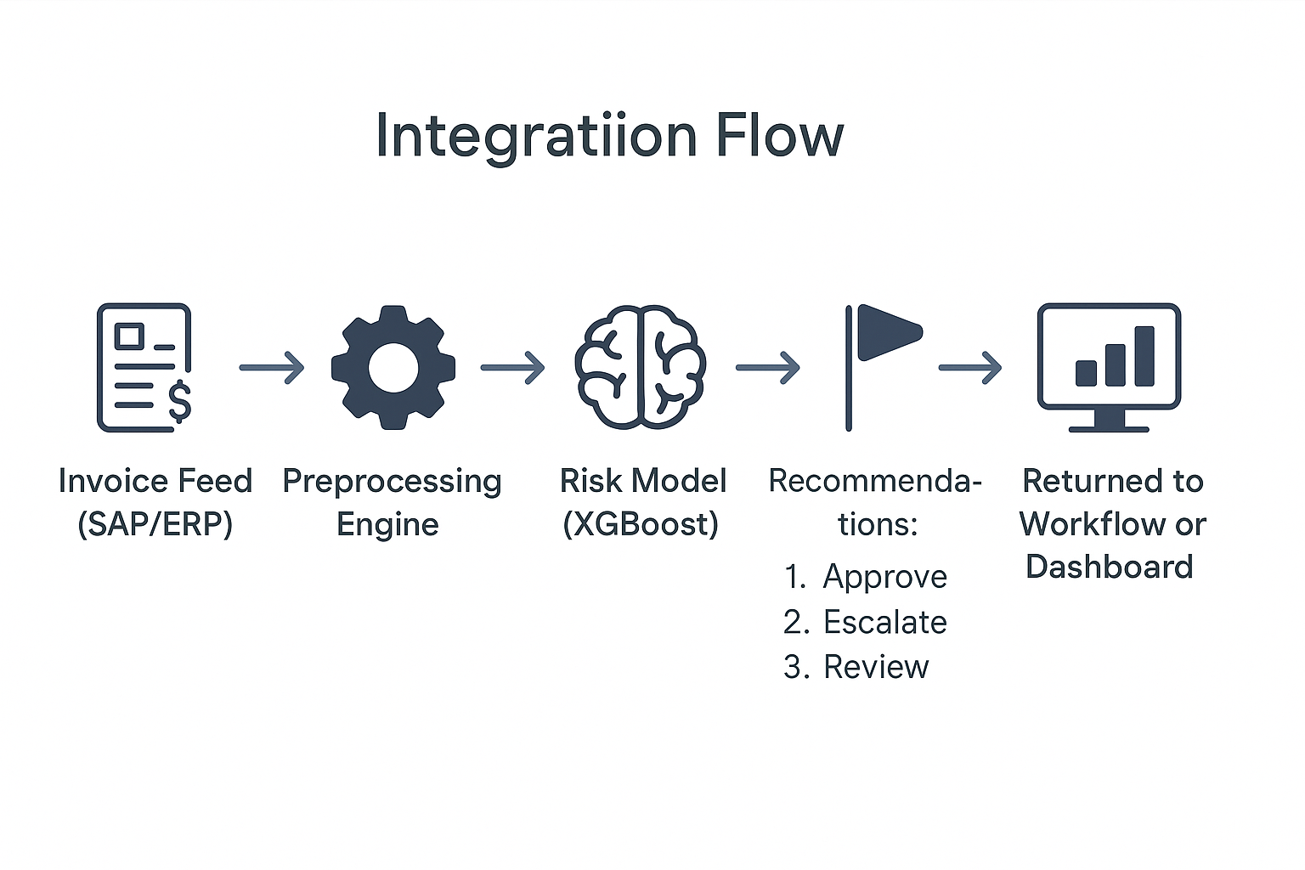
Implementation & Integration – What It Takes to Deploy This
“This system is designed to act as an intelligent layer that can sit on top of your existing Accounts Payable infrastructure. It doesn’t replace your ERP or invoice approval workflow — it enhances it.”
“Here’s how integration typically works:
We connect to your invoice feed — whether that’s from SAP, Oracle, NetSuite, or even CSV uploads
Data is pre-processed either daily or in real-time
The model runs, scores each invoice, and returns an action recommendation
And then those recommendations feed directly into your workflow rules: approve, escalate, or review.”
🧩 Non-invasive — works with your existing AP tools
⚙️ Plugs into SAP, Oracle, NetSuite, etc.
🔁 Real-time or batch scoring
🖥️ Flexible delivery: dashboard, API, or embedded
🧪 Phased rollout: test, observe, activate

Slide 23
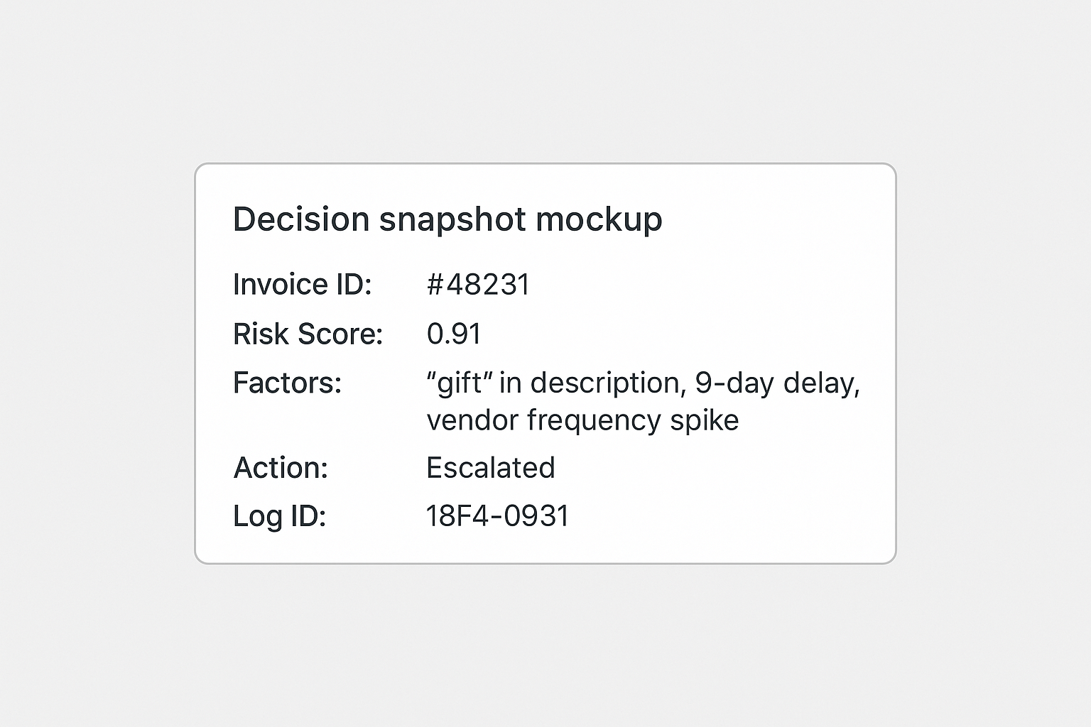
Governance & Trust – Explaining the Black Box
“Firstly, the system provides a confidence score with every prediction. So it’s not just saying ‘yes’ or ‘no’ — it’s telling you how sure it is, and why.”
“Secondly, the model tracks feature importance — meaning it can explain:
Which factors contributed to a flag
How the combination of amount, vendor behavior, and text led to that decision
And what past patterns it’s referencing”
“And third — we maintain a full decision log: Every prediction, every risk flag, and every override or confirmation by your team is recorded. That becomes a fully auditable risk journal.”
“So instead of a black box, this is a glass box — explainable, traceable, and controllable.”

Slide 24
“Here’s what we’ve achieved:
We identified the 3 main risk zones in Accounts Payable: late payments, suspicious text, and behavioral anomalies
We built a system that learns from your historical data — and flags risk based on patterns, not gut feeling
We tested multiple models and selected the one that delivered the highest precision and the lowest false alarms
We proved that the system works — with over 90% accuracy and full audit traceability
And we showed how this plugs directly into your existing finance flow — no rebuilds, no heavy lift, just intelligent decision support”
🧠 AI Engine Built On | XGBoost (Ensemble ML)
📊 Accuracy Achieved | 90%+ with strong precision & recall
🧾 Risks Flagged | Late payments, unusual vendors, suspicious text
🧩 Integration | SAP, Oracle, NetSuite, CSV, API-ready
🔐 Governance | Fully explainable & auditable
💸 Business Impact | Reduced losses, faster reviews, better compliance

Slide 25
Call to Action
We recommend a 3-phase rollout approach, built to minimize disruption and maximize value from Day 1.”
🔹 Phase 1: Shadow Mode (Pilot)
“We plug the AI engine into your invoice data stream, but it won’t affect live operations yet. It runs in the background, flags risk, and gives you a preview of its insight. You compare its results with your team’s — and evaluate trust.”
Phase 2: Human-in-the-Loop Deployment
“You activate the model in partial production. High-risk invoices are flagged for review, while everything else proceeds normally. This gives your finance team oversight and confidence.”
Phase 3: Intelligent Automation at Scale
“Once confidence is high, the system becomes your default risk triage tool. It scores everything, flags intelligently, and reduces manual workload across the board.

